Slide 1
An Introduction to Game-Based Assessment
Tom Heinzen
William Paterson University
For 2013 Best Practices Conference, Atlanta GA

Slide 2
With thanks, for many different reasons, to
D. A. Bensley, scale development
S. O. Lilienfeld, scale development
M. Gordon, experimental psychologist
S. Richman, user experience specialist
T. Shendervich, animator
Notes:
And, of course, there are many other people to thank.

Slide 3
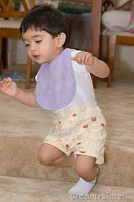
A Major Assumption: Students love being assessed.
They just don’t like how we’ve been doing it. However, people do love to:
compare themselves to others;
overcome obstacles; and
demonstrate mastery.
People love to be assessed.
Current approaches punish failure.
But failure (like falling) is already its own punishment.
Notes:
There is a major assumption about game-based assessment, or GBA, that you may not buy but I am going to try to sell you:
Our students love to be assessed.
They just don’t like the ways we’ve been doing it.
But we self-assess all the time by a) making social comparisons; b) by overcoming obstacles; and c) mastering skills and demonstrating our mastery.
Our current assessment approaches punish failure. You start with an A and every time you do something wrong, your grade goes down.
But we don’t need to punish failing because failure is already its own punishment.

Slide 4
Six Critical Definitions
Assessment is the authentic evaluation of teaching and learning outcomes (See Dunn et al., 2011; Heinzen et al., in press; Schnell, 2008).
Gamification is the application of principles of game design to non-game situations.
Game-Based Assessment (GBA) applies principles of games to assess students’ skills and knowledge (in psychology).
A game is a situation in which participants voluntarily try to overcome unnecessary obstacles (i.e. rules and goals).
Play is the exuberant expenditure of energy in aimless activities.
Fun is any intrinsically motivated, engaging activity.
Gamification does not necessarily involve computer games!
Notes:
I will let you read those definitions for yourself. I have underlined a key word-idea in each definition.
In the definition of “game,” I also like the idea of “unnecessary obstacles.” It sounds like how we design a course.

Slide 5
What are we trying to assess?
The APA’s goals are for undergraduates to demonstrate…
Scientific Inquiry and Critical Thinking
Ethical and Social Responsibility
Communication
Professional Development
Knowledge Base in Psychology
Notes:
The APA has already helpfully clarified, in much more detail than these five general areas, exactly what psychology students should be able to demonstrate in terms of knowledge and skills.
The only one we assess very well is knowledge of psychology, and we typically do not that through a multiple choice test.

Slide 6
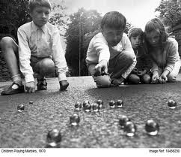
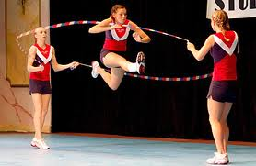
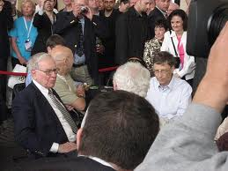
What’s good about games?
Games develop skills and promote cooperation.
Games can be “hard fun.”
Games are popular and familiar to students.
Notes:
----- Meeting Notes (3/14/13 09:19) -----
There are lots of good things about games, but I like this middle photograph best of all.
It shows that games can develop skills and promote cooperation.
Games can be difficult, by design: hard fun.
And games are popular; and that is important for the success of GBA.

Slide 7
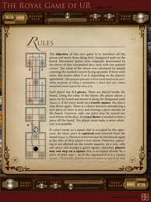
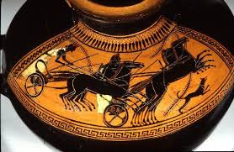
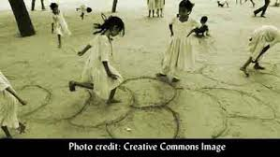
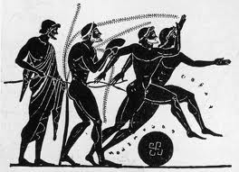
Games are ancient; (multiple choice tests are not).
Notes:
----- Meeting Notes (3/14/13 09:19) -----
Games are also ancient. They have been a deep part of the human experience for a long time.

Slide 8
Games are our present…
Cityville launched in 2011 and went from 0 – 100 million users in 41 days.
Video gaming is a 66 billion dollar industry (double Hollywood); online sales will surpass retail sales this coming year (in 2013). China is the biggest online market.
> $8 billion was spent on supportive goods such as cyber seeds for Farmville.
Successful games are NOT just about blowing stuff up:
Sandbox (Minecraft) Building (Civilization, Sim City)
Social Building (Farmville) MMOGs (World of Warcraft)
Puzzles (Portal 2, Angry Birds) Vocabulary (Words With Friends)
Notes:
And we all know that games are a big part of our present.
Wouldn’t it be nice if a psychological science game found 100 million users in just 41 days?
It’s also a big industry.
Very big.
And it’s not just about teenage boys blowing stuff up.

Slide 9
Games are in our future because…
“We’re witnessing what amounts to no less than a mass exodus to virtual worlds and online game environments” (Economist Edward Castronova).
The 10,000 Hour Principle has been at work for several years (Ericsson, Krampe, & Tesch-Romer, 1993).
There are 500 million gamers who “are extraordinarily good at something” (Jane McGonigal’s TED talk).
Notes:
Games will be an important element of our future, too. Edward Castronova describes a “mass exodus to virtual worlds.”
The 10,000 hour principle has been at work for a long time; students spend about 10,000 hours in school between 5th grade and graduation – and the equivalent number of hours playing games.
Jane McGonigal estimates that there are some 500 millions of gamers who are “extraordinarily good at something.”

Slide 10
Gamers are already good at characteristics employers want:
acting with urgent optimism (an “epic win” is always possible);
weaving a tight social fabric (gaming requires and creates trust);
experiencing blissful productivity (they are happier working hard at gaming);
pursuing epic meaning (world of warcraft wiki is the second largest wiki in the world with 5 million users per month).
Notes:
Urgent optimism means a good attitude.
A tight social fabric means gamers can get along with others.
Blissful productivity suggests that gamers love their work.
And epic meaning suggests that gamers want to find meaning in their professional lives.

Slide 11
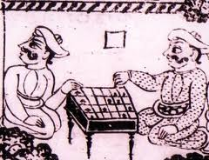
Game Characteristics Fit a Liberal Arts Education (mostly from Nicole Lazarro)
Games are hard fun that involve overcoming progressively more difficult obstacles.
Games engage the entire person through ambiguity and incompleteness.
Games create opportunities for meaningful growth through social comparisons, competition, cooperation, evaluated performance, and public spectacles.
Games present ethical dilemmas.
Notes:
Games are compatible with a liberal arts education.
I especially love this ancient image of someone who appears to be cheating at checkers.

Slide 12
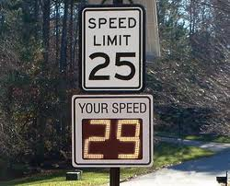
Why Now?
We have a growing base of students for whom playing games is the social norm.
Social media is already connecting people through games.
Game design in already being applied in non-game settings.
This automatic feedback loop places
drivers who obey the speed limit in a
lottery funded by drivers who do not
obey the speed limit.
Notes:
The time is right for a game-based assessment because gaming is now a social norm that connects people in many ways, including through social media.
In this traffic game, the good drivers who obey the speed limit are placed in a lottery that is funded by the bad drivers.

Slide 13
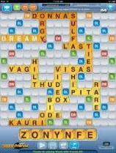
Who Are Gamers? (not necessarily peer-reviewed)
You. (The average gamer is 30 years old).
44% of US/UK adults played a mobile game last month.
47% of players are female.
97% of 12-17 year olds play video games (in US/UK).
The average student has chosen to spend as many hours gaming as they have spent in high school classes.
Sources: Nicole Lazarro, Pres. of XEO Design, K. Werbach and Dan Hunter in For the Win, Lee Sheldon in The Multiplayer Classroom, Jane McGonigal in multiple TED talks, Gilman Louie of Alsop-Louie Partners.
Notes:
Gamers are everywhere. Try asking your students what an epic win is.
They will probably stare at you with surprise that you know the term.
But the phrase, and the idea, are an important part of how our students think and feel.

Slide 14
The Language of Game Design is Code for the Language of Psychology
Badges are earned symbols of achievement that may provide prestigious titles and new abilities.
Boss corresponds to an extremely hard challenge, such as a midterm, final, or some unexpected, bizarre challenge that must be overcome.
Character Level – Each player starts completes missions to earn experience points to repeatedly level up his/her character.
Checkpoint corresponds to progressively more difficult exams that offer a brief resting point.
Easter Eggs are unexpected rewards that, like a variable schedule of reinforcement, create persistence.
Notes:
Gamers have evolved their own language and it parallels many concepts in psychology. I will only discuss the bold-printed terms but I would you to glance at these others terms.
An Easter Eggs is any surprise reward. Getting upgraded to first class is an Easter Egg. Earning surprise bonus points for consecutive correct answers is an Easter Egg.

Slide 15
Epic Fail is a stupid failure at something that should have been easy to achieve.
Epic Win is a rare, positive, major achievement such as earning an A in a difficult class or presenting at a conference.
Experience Points are point rewards for many things ranging from staying in the game to specific achievements.
Games create a situation in which participants voluntarily try to overcome unnecessary obstacles (outlined in our syllabi).
Game design uses contrived contingencies that resolve with unequal outcomes by requiring meaningful choices that solve problems in ways that provide interpretable outcomes.
Game Level is a particular achievement level within a game; like many textbooks, higher levels are more difficult and depend on achievements at lower levels.
Notes:
After one of my students finished his first poster presentation at a conference, I asked him what it felt like. He smiled and said, “Like an epic win.” Gamers love grandiose language and it probably reflects a richer desire fo meaning and a sense of purpose.

Slide 16
Glitch is an error in a course or game that allows people to cheat. (Designed glitches can be used to assess ethical behavior.)
Leaderboards provide social comparisons in both courses and games that encourage competition and provide regular, meaningful feedback.
Leaderboards provide social comparisons in both courses and games that encourage competition and provide regular, meaningful feedback.
Leveling Up provides some sort of reward for the time you have invested, a recognized achievement at a higher level.
Max Level (or Level Cap) is the highest possible achievement at which your character unlocks all of its abilities.
Notes:
A glitch is a mistake in the computer program that lets others cheat. But we can design glitches into our games to create ethical dilemmas and assess that element of the APA guidelines.

Slide 17
Noob or Newbie is a new player who probably needs help because she or her does not yet understand the rules.
Play is the expenditure of exuberant energy in aimless activities.
Points in a game are calibrated more thoughtfully than many syllabi to take advantage of partial reinforcement to keep people motivated.
Rage Quit (or Rage Out) describes a level of frustration that leads to leaving the class or dropping out of a game.
Trolls and Trolling are social deviants within a game, people who take malicious pleasure (blowing things up) at making life difficult for others.
Training Level A training level which corresponds to the first day of class when the rules of the game are discussed.
Notes:
Rage quit is what happens to some 50%, plus or minus, of our students who drop out of college. I’ve been working on a game-based student retention policy that takes advantage of what may be the most powerful experience in higher education: The joy our students experience at graduation. But why do we withhold that Joy until the very last moment. Why not provide real recognition badges for passing statistics and experimental design, for example. We could strategically sprinkle motivation across the curriculum to help keep our students on track.

Slide 18
So, students in a gamified course will
…earn rewards by expending exuberant energy to overcome obstacles by making meaningful choices that solve real problems in order to achieve an epic win.
Notes:
Read this to yourself because it describes what students could experience in every course.

Slide 19
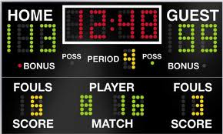
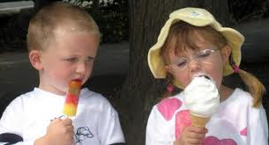
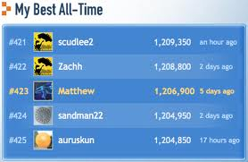
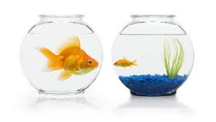
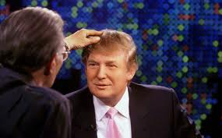
Summary: Why might GBA work?
1. GBA provides prompt (automatic) feedback.
2. GBA provides motivating social comparisons.
3. GBA is scalable (100,000 psych majors/year).
4. GBA minimizes a fear of failure (you never really lose; you just start over).
Social
Comparisons
Notes:
There’s no more waiting three days or three weeks for the professor to return a test; the feedback is automatic. That makes our lives easier.
Social comparison is natural form of assessment. That little boy with the ice popsicle was happy… until he saw what she had.
GBA is scalable and I don’t see any other way for us to assess the 100,000 psychology majors we graduate each year.
GBA uses failure as a strategic obstacle rather than as a club.

Slide 20
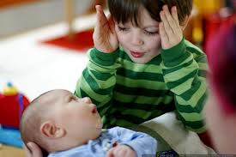
5. GBA is closer to a natural form of learning;
6. GBA can be simple (has face validity).
7. GBA can cross gender and ethnic groupings.
8. GBA blends extrinsic motivation (points) with intrinsic motivation (fun).
9. GBA captures optimal student performance.
10. GBA can be comprehensive (because students will spend many hours playing interesting games).
Natural
Learning
Notes:
----- Meeting Notes (3/14/13 09:19) -----
Trying and failing is a natural way to learn and even simple games can be effective.
GBA can be designed, tested, and redesigned to cross gender and cultural boundaries.
Games rely on both extrinsic and intrinsic motivation and that has pleasing consequences.
Namely, students are now trying to do their best because they are having fun.
That also means that we can conduct comprehensive assessments because they will eagerly keep playing assessment games for 30 or 40 hours instead of begrudgingly spending two hours on a multiple choice exam.

Slide 21
Volkswagon Corp. is funding an approach to social change called Fun Theory.
Notes:
Academics, as usual, is late to the party.

Slide 24
Many companies already monetize points.
An unexpected airline upgrade
is a game-designed Easter Egg.

Slide 25
A Gamified Statistics Course Novice N | Competent C | Relational R | Skilled S | Expert E | Knowledge Creator KC
Levels 1-6 (10 points each)
Types of Statistics
Transforming Observations
Types of Variables
Hypothesis Testing
Levels 7-11 (20 points each)
The z Table
Assumptions
Steps of Hypothesis Testing
Applying APA Style
Level 12-15 (30 points each)
Two-Way ANOVA
Understanding Interactions in ANOVA
Conducting a Two-Way Between-Groups ANOVA
Level 16+Project (50 points each)
Choosing the Appropriate Test
Applying the Appropriate Test
Notes:
I gamified by first stats course out of desperation after Hurricane Sandy took away what amounted to four, one-night-per-week classes. First, I quickly refined my goals: to enable them to use SPSS and to understand what they were doing. Second, I stopped lecturing and spent each class going from terminal to terminal. Third, I required lots of homework from the text, created data sets for each chapter, and spent class helping them with their data sets. I didn’t yet know that that was called a flipped classroom. In the first week back, they finished data sets for Chapters 1 & 2. The next week they had to analyze new data sets for Chapters 1 & 2, plus analyze data for Chapters 3 & 4. The next week they had new data for Chapters 1&2, 3&4, plus 5 & 6. By that time they were complaining that there was no point in doing Chapters 1 & 2 again because they knew it so well – which was the point, so I dropped it but repeated the process through higher levels that, as they became more difficult, gave them opportunities to earn more points.

Slide 26
Some candid student comments after a gamified statistics course:
Trial and error were good. There was no real help along the way, but there were no consequences.
I like that we got to leave early if we learned all we needed to know for that week.
I liked having someone other than the professor teach me; it was much better. (!)
As professor, I was increasingly perceived as unnecessary to the learning process!
Notes:
I assessed the course in a variety of ways. Students are wonderful; they just say what they mean and I should have been offended, but fortunately I got over that.
For example, I spent every class going from one student to the next; all class; they could all hear me and see me; for 3-4 hours. Yet this student wrote, “there was no real help.”
When advanced students finished more quickly, I let them leave. But many of them chose to stay and help. These were students who needed tutoring but wouldn’t go due to a combination of busy schedules, lack of motivation, and embarrassment.
But they didn’t getting tutored by their class peers. In fact, this student wrote, “It was much better” than the professor.
I realized something wonderful. I was becoming unnecessary.

Slide 27
When, if ever, did you experience something like an “epic win”?
When I began to be able to do the material and solve problems alone.
Whenever I finished a new level I felt that I accomplished it.
Completing the practice tests and doing them correctly.
Notes:
I also asked them if they had experienced anything like an epic win during the course.
Here’s what they said.
It was all related to having developed skills.

Slide 28
Ancillary benefits flow out of good design.
I inadvertently did several things well by
Allowing high achieving others to teach other students
Rewarding them with the privilege of leaving early (!)
Giving them self-paced practice
Keeping their attention for four hours each class
Becoming more confident in the fairness of the tests, including when students deserved to fail
Notes:
Lots of good things seem to flow out of a good design.
For my part, I was confident in my grading scheme. When students failed, I knew they deserved it. And students could not earn an A unless they deserved it.

Slide 29
Other data (from Gordon) suggest that More points = Greater motivation
Notes:
We love points… lots and lots of points. The game Words With Friends is like Scrabble, but sometimes I can spell a word that earn 150 points and I secretly feel as if I am better at Words With Friends than I am at Scrabble!

Slide 30
When students created the syllabus… Nothing but Bonus Points!
Be the Teacher
Time Attack
King of the Hill
Lottery System
Group Cutthroat
(WPU Students Justin Ali and Corey Sussman)
Notes:
I don’t happen to like Bonus points, but when I asked my students to design a scoring system for a course, they designed a course that was ONLY bonus points. Which, of course, amounts to the same thing as having no bonus points. But it felt like a voluntary effort, like a game.

Slide 31
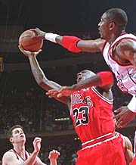
Game design communicates a different attitude toward failure.
Approach motivation
Fear & Withdrawal
“I've missed more than 9000 shots in my career. I've lost almost 300 games. 26 times, I've been trusted to take the game winning shot and missed. I've failed over and over and over again in my life. And that is why I succeed.”
~ Michael Jordan
Notes:
And, of course, game-based assessment takes a completely new approach to failure; an approach that is more comparable to what we experience in real life. It’s true for professors, too, who may apply for promotion year after year until they get to their reward.

Slide 32
Two warnings:
The over-justification effect.
The faddishness of the education industry.
Let’s play some games.
(Sorry, they are still just story boards.)
Notes:
The overjustification effect occurs when extrinsic motivators undermine intrinsic motivation. When you started getting paid for doing what you loved, you will now only do for money. The game community bumped into this social psychological insight with a bang when they discovered that they could not just slap PBLs (Points, Badges, and Leaderboards) on existing structures. Companies that gamified products that were already selling well, found that their sales declined after gamifying the process.
And I worry about the faddishness of the education industry.
Gamification, however, has already been sticking around for several years, and it’s only going to get better.

Slide 33
References
Dunn, D. S., McCarthy, M. A., Baker, S. C., & Halonen, J. S. (Eds.) (2011). Using quality benchmarks for assessing and developing undergraduate programs. San Francisco, CA: Jossey-Bass.
Heinzen, T. E., Landrum, R. E., Gurung, A. R., & Dunn, D. S. (in press). In Gamification for Business and Education (T. Reiners & L. C. Wood, Eds.), New York: Springer.
Schnell, J. (2008). The art of game design. Boca Raton, FL: CRC Press.
Suls, J., Martin, R., & Wheeler, C. (2002). Social comparison: Why, with whom, and with what effect? Current Directions in Psychological Science, 11, 159-163.
Wu, Michael. Gamification from a Company of Pro Gamers. Retrieved January 14, 2012, fromhttp://lithosphere.lithium.com/t5/Building-Community-the-Platform/Gamification-from-a-Company-of-Pro-Gamers/ba-p/19258
Se also Richard Bartle, Hearts, Clubs, Diamonds, Spades: Players who suit MUDs, http://mud.co.uk/richard/hcds.htm
Additional information is available in Deloitte Consulting LLP (2012), "Tech Trends 2012: Elevate IT for digital business", www.deloitte.com/us/techtrends2012, Chapter 1.
Additional information is available in Deloitte Consulting LLP (2012), "Tech Trends 2012: Elevate IT for digital business", www.deloitte.com/us/techtrends2012, Chapter 4.
Additional information is available in Deloitte Consulting LLP (2012), "Tech Trends 2012: Elevate IT for digital business", www.deloitte.com/us/techtrends2012, Chapter 9.

Slide 34
Each of the following three games represents just one of several games within a particular domain.

Slide 35
Stat Wizard
Game 1: Name That Test
(Applying statistical knowledge)

Slide 36
Review this decision tree about which hypothesis test to use in different situations.
Only scale variables
Interval
Question about association
Pearson Correlation
Only nominal variables
Categorical
One nominal variable
Chi-square test of goodness-of-fit
Two nominal variables
Chi-square test of independence
Question about prediction
Regression
Nominal IV and Scale DV
Sample decision tree (Appendix E):

Slide 37
1. The degree of association between any two scale measures.
Z test
Single sample t test
Paired samples t test
Pearson correlation
Regression
Independent sample t test
Factorial ANOVA
One-way within- groups ANOVA
One-way between-groups ANOVA
Chi-square test for goodness of fit
Chi-square test for independence
Spearman rank-order correlation
Wilcoxon signed-rank test
Mann-Whitney U test
Kruskal-Wallis H test

Slide 38
2. A question about prediction using only scale variables.
Z test
Single sample t test
Paired samples t test
Pearson correlation
Regression
Independent sample t test
Factorial ANOVA
One-way within- groups ANOVA
One-way between-groups ANOVA
Chi-square test for goodness of fit
Chi-square test for independence
Spearman rank-order correlation
Wilcoxon signed-rank test
Mann-Whitney U test
Kruskal-Wallis H test

Slide 39
3. Gender differences in the scaled variable of optimism?
Z test
Single sample t test
Paired samples t test
Pearson correlation
Regression
Independent sample t test
Factorial ANOVA
One-way within- groups ANOVA
One-way between-groups ANOVA
Chi-square test for goodness of fit
Chi-square test for independence
Spearman rank-order correlation
Wilcoxon signed-rank test
Mann-Whitney U test
Kruskal-Wallis H test

Slide 40
4. The relation between gender and income in four different neighborhoods.
Z test
Single sample t test
Paired samples t test
Pearson correlation
Regression
Independent sample t test
Factorial ANOVA
One-way within- groups ANOVA
One-way between-groups ANOVA
Chi-square test for goodness of fit
Chi-square test for independence
Spearman rank-order correlation
Wilcoxon signed-rank test
Mann-Whitney U test
Kruskal-Wallis H test

Slide 41
Some Game Mechanics
The ~ 40 questions gradually become more difficult, applied, and worth more points.
Students achieve certification badges when they correctly answer subsets of questions: 4 levels; 4 badges.
Students can take this exam until they earn 100%.
In the background, we are measuring time to complete, number of attempts, and accuracy – and sending all that information to a spread sheet.
It needs standard psychometric development (reliabilities and most of the validities).
An empirical question: What is the most motivating game response to failure (a wrong answer) and success?

Slide 42
Stinkin’ Thinkin’
The Job Interview
(Distinguishing between types of variables)

Slide 43
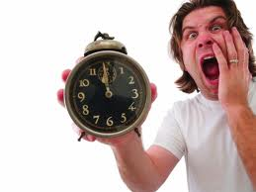
Stinkin’ Thinkin’
A newly graduated psychology major was running late for a job interview.

Slide 44
Stinkin’ Thinkin’
While getting ready for the interview, she experienced a persistent intuition:

Slide 45
Stinkin’ Thinkin’
Being late might not make a good first impression on the interviewer.

Slide 46
Stinkin’ Thinkin’
He imagined sweating during his job interview.

Slide 47
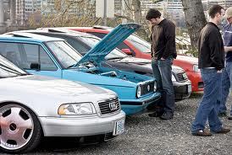
Stinkin’ Thinkin’
So he rushed out to his brand new car,

Slide 48
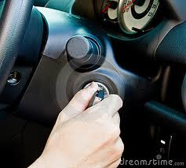
Stinkin’ Thinkin’
…turned the key and guess what?

Slide 49
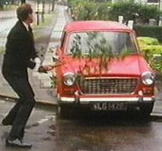
Stinkin’ Thinkin’
The car wouldn’t start.

Slide 50
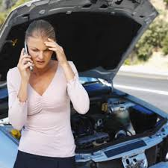
Stinkin’ Thinkin’
Plus, her cell phone was dead…

Slide 51
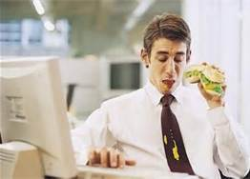
Stinkin’ Thinkin’
…and he noticed a small mustard stain on his tie.

Slide 52
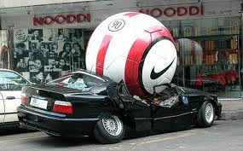
Stinkin’ Thinkin’
All in all, she just didn’t feel quite ready to drive to an important job interview.

Slide 53
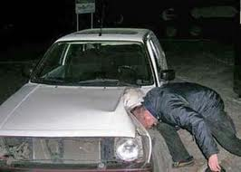
Stinkin’ Thinkin’
He felt discouraged...

Slide 54
Stinkin’ Thinkin’
….and frustrated…

Slide 55
Stinkin’ Thinkin’
…so he started to think.

Slide 56
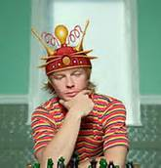
Stinkin’ Thinkin’
How can I get my car to start?

Slide 57
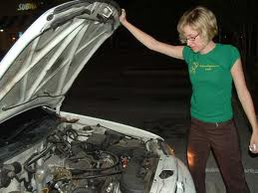
Stinkin’ Thinkin’
Before trying to start the car again, she experimented with several interventions such as…
…staring at the engine with her mighty psychic powers…

Slide 58
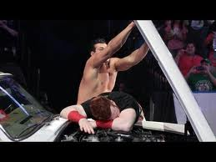
Stinkin’ Thinkin’
…slamming the hood…

Slide 59
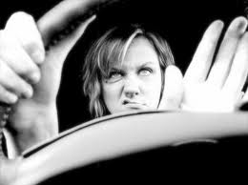
Stinkin’ Thinkin’
…hitting the steering wheel in frustration…

Slide 60
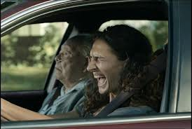
Stinkin’ Thinkin’
…and screaming…

Slide 61
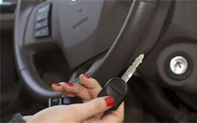
Stinkin’ Thinkin’
…putting the key into the ignition very, very slowly…

Slide 62
Stinkin’ Thinkin’
After doing all these things, he turned the key again, and guess what…

Slide 63
Stinkin’ Thinkin’
The car started!

Slide 64
Stinkin’ Thinkin’
The world seemed like a wonderful place once again!

Slide 65
Stinkin’ Thinkin’
He felt like he would nail the interview!

Slide 66
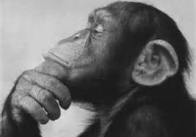
Stinkin’ Thinkin’
But he still had one burning question:

Slide 67
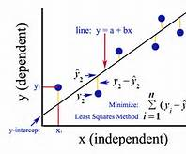
Stinkin’ Thinkin’
What had caused the car to start?

Slide 68
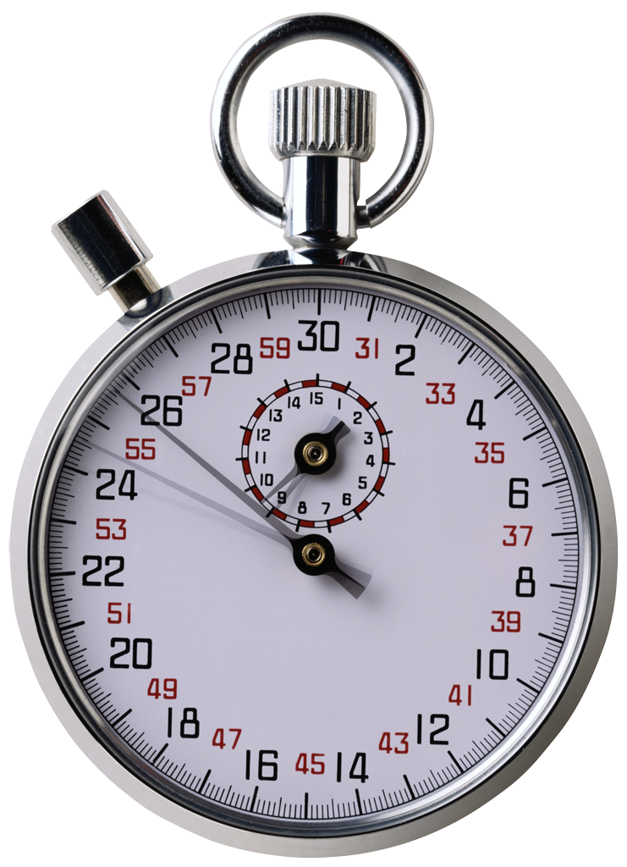
Stinkin’ Thinkin’
Examine the boxes on this page. Then click START and drag and drop each box into the appropriate column in the next slide. Work as quickly as you can until you have placed every box in the appropriate column.
Screaming
Slamming the hood
Ways to get the car to start
The car starts or does not start
Having a dead cell phone
Putting the key in very slowly
Using psychic powers
Hitting the steering wheel
Worrying about sweating
Being worried about the interview
One of these influences caused the car to start
None of these influences caused the car to start
One of these influences may have caused the car to start.
START

Slide 69
Screaming
Slamming the hood
Ways to get the car to start
The car starts or does not start
Having a dead cell phone
Putting the key in very slowly
Using psychic powers
Hitting the steering wheel
Worrying about sweating
Being worried about the interview
One of these influences caused the car to start
None of these influences caused the car to start
One of these influences may have caused the car to start.
Independent Variable(s) | Dependent Variable(s) | Alternative Explanation(s) | Extraneous influence(s) | A Logical Conclusion | An Illogical Conclusion

Slide 70
Stinkin’ Thinkin’
We need to
Know how many attempts they made to get each correct answer
Know how long it took.
Tabulate accumulating points for correct answers.
Assign bonus points for correct answers in a row.
Create an anonymous leaderboard.
Tabulate how often they switched answers.
Provide a recognizable acoustic reward (“Ding!”?) for correct answers and a polite signal for incorrect answers.
These are almost all manageable, empirical issues.

Slide 71
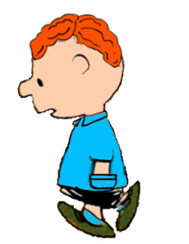
Help Donny (Knowledge of Psychology)
FairLawn, NJ
Designed by Sam Richman
(User Experience Strategist)
The foundational scale was developed by D. Alan Bensley
and Scott Lilienfeld and may not be used without their permission.

Slide 72
Hello Counselor-in-Training, please enter your
Name_______
Graduation Year______
(Other demographics; tbd)

Slide 73
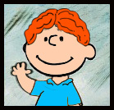
Welcome ________, meet Donny.
Your new client, Donny, is a 21 year old Caucasian male, currently finishing up his bachelors in philosophy.

Slide 74
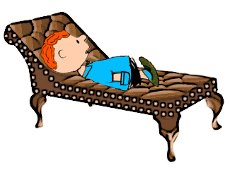
Note to SR: The couch image is outdated so it doesn’t work, especially in a test of myths about popular psychology. TH
Your task is to use your knowledge of
scientific psychology, even if it contradicts
your intuition, to help Donny make some
Important life decisions.

Slide 75
Description of Introduction
1. Buzzing noise
2. User opening the door to let Donny in
3. (User dialogue box) “Hello Donny, my name is _______”
4. (Donny) “Hi _________”
5. (User dialogue box) “So, Donny, what brings you here?”

Slide 76
“I am stressed out about final exams and then leaving school. I don’t know what I want to do with my life, what I believe, or who I am. I am totally confused.”

Slide 77
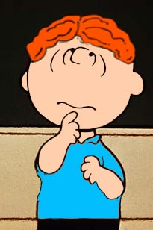
“For example, in my Philosophy class, my teacher tailored her teaching style to each students’ learning style. Will that help my test scores?”

Slide 78
Well, Donny, I can’t know how you will score, but studies indicate that learning is best when a teaching style matches a learning style.
Well, Donny, I can’t know how you will score, but studies indicate that matching teaching styles to learning styles has no effect on actual learning.

Slide 79
“I’ve been feeling really down on myself lately. My father says I need to work on my self-esteem. Is building my self-esteem likely to help me earn higher grades?”

Slide 80
A) I’m sorry Donny, but building self-esteem does not, on average, seem to help academic performance; your best bet is probably to study more. B) Your father is right, Donny. Raising your self-esteem is, on average, a proven method for improving academic achievement.

Slide 81
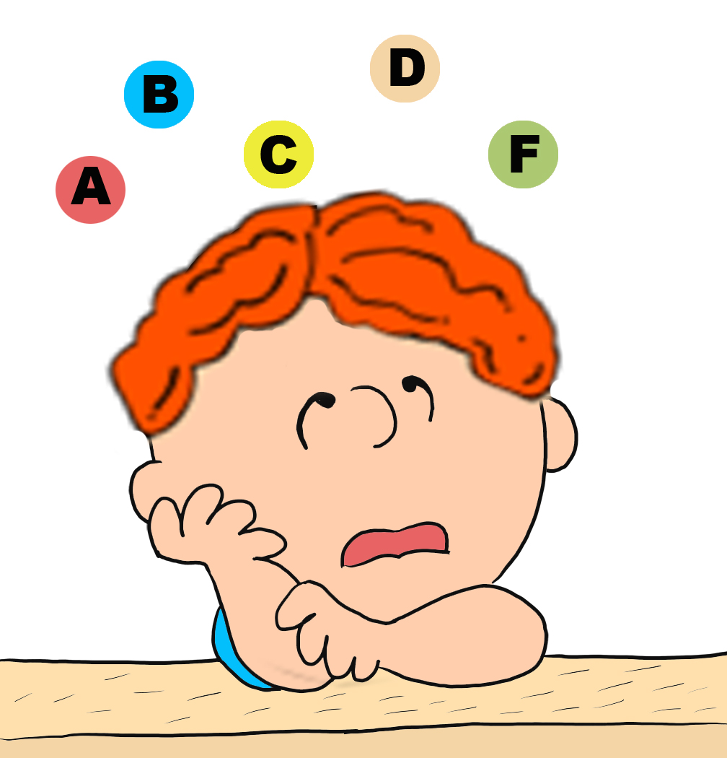
“When I take a test, I keep second-guessing my answers. Should I go with my first impulse or is it better to go back over the answers?”

Slide 82
A) Stick with your first hunch; you can almost always trust your intuition.
B) Go over the questions you are worried about and change them if you think another answer might be better.

Slide 83
“Am I bad at math because I’m left handed and right brained? Is that why math courses are so difficult for me?”

Slide 84
A) It’s true, Donny. Right-brained people usually lean more towards the arts. Even if you’re not great at math, you are probably more creative than most left-brained people.
B) That’s a myth, Donny. Which hemisphere of the brain is dominant doesn’t seem to matter. You probably just need to study more effectively.

Slide 85
“Well, I finally graduated, but I still feel lost. I went on my 6th job interview and my father gave me a long lecture about my lack of ambition, blah blah blah. I am so angry, I could explode! What should I do?”

Slide 86
A) Try punching a pillow. It will help you blow off steam and redirect your anger without actually harming anyone.
B) Try listening to music or going for a walk. Distraction and self-control are better ways to manage your anger.

Slide 87
“I’ve been very depressed for a long time and drug treatments don’t seem to help. What about electroconvulsive therapy?”

Slide 88
A) Don’t do it, Donny! ECT is a dangerous, brutal, and primitive treatment and it won’t affect depression.
B) Well, Donny, ECT can be an effective treatment that has been safely used to treat depression.

Slide 89
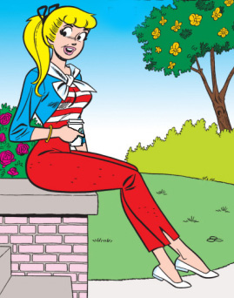
“Guess what? I finally found a job and a small apartment far away from my father. Plus, during my coffee breaks, I keep running into this very attractive woman and discovered that we have the same tastes in music. She laughs at my jokes and even orders the same coffee drink!”

Slide 90
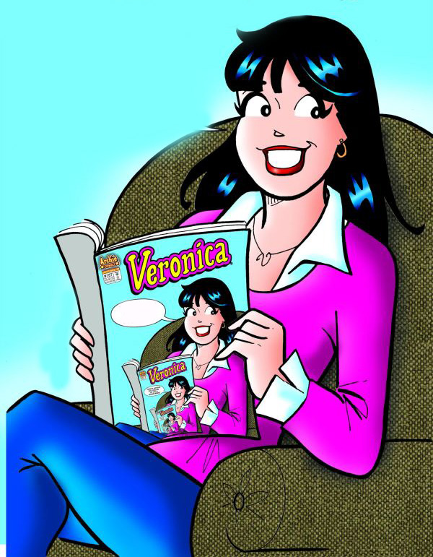
“In fact, there’s another young, attractive woman in my apartment building. We don’t have much in common; she’s so different that I find her interesting. We disagree on movies, music, religion, and even politics!”

Slide 91
“I want to ask one of them on a date, but I’m not sure which. I’d love to know your thoughts, I can’t stop thinking about it.”

Slide 92
A) Well, Donny, studies support the folk wisdom that birds of a feather flock together.
B) Well, Donny, studies support the folk wisdom that opposites attract.

Slide 93
“So my date was a lot of fun, but I never knew what she wanted, like should I pay? Or did she want me to kiss her? Sometimes she’d just give me this look that I didn’t understand. Why don’t we communicate better?”

Slide 94
Donny, when it comes to communication, men and women are far more similar than they are different.
Donny, when men and women try to communicate, it’s like “men are from Mars and women are from Venus.”

Slide 95
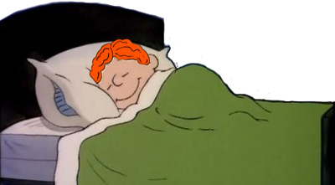
“I see the woman in my building all the time, now; I even had a dream about her. Is my subconscious trying to tell me she’s the one for me or was it just because I’ve spent more time with her?”

Slide 96
A) It’s most likely your dream is simply due to the amount of time you have spent with her.
B) It’s most likely your dream has important symbolic meaning indicating that she really could be the one for you.

Slide 97
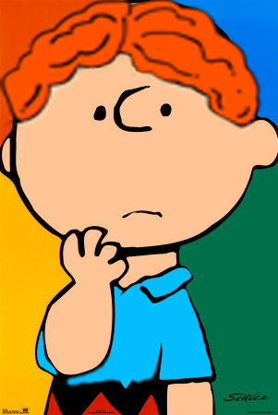
Two Possible Profiles of Donny After Section #1 – The gamer-therapist never gave the scientific response.
Profile 1:
Donny is not doing well in therapy.
Donny has no job, no money, is depressed, and unmotivated. He can’t get into graduate school, and fights with his father and even with his few remaining friends.
He’s also in a bad relationship but won’t try to get out of it.
Quality of Life

Slide 98
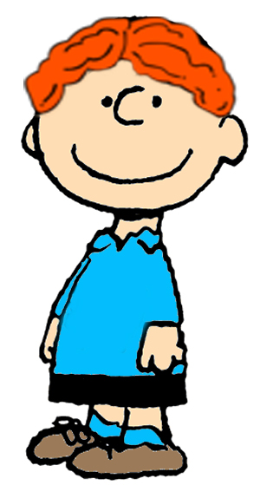
The gamer-therapist gave the scientific response 5 out of 8 times.
Profile 2:
Donny is making some progress in therapy.
Donny has a job, is saving money, is less depressed, and more motivated. He still fights with his father but is making plans to take charge of his future.
He’s in a relationship that has both ups and downs and is more willing to work at it.
Quality of Life

Slide 99
Critical Advantages of GBA Over Multiple Choice Tests:
GBA conforms to standard psychometric practice by using multiple types of measures multiple times.
GBA captures student performance when participants are motivated to do their best.
GBA can be played enthusiastically for many hours over many days, controlling for transitory influences.
GBA allows comprehensive assessment across many domains rather than cramming four years of learning into a 3-hour MC test.
GBA provides many opportunities to demonstrate diverse skills in varied applied settings.

Slide 100
Thank you.
Questions and comments?

